Slide 1
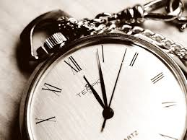
Time Management
BY:
Dr. Seun Ebiesuwa,
Lecturer, Computer Science Department, Babcock University

Slide 2
Presentation Outline
What is Time?
Time Management Defined
Reasons why students ought to Internalize the Time Management Concept
Perils Associated with Failure to imbibe Time Management
Learn to Set Goals

Slide 3
Presentation Outline (Contd.)
Prioritize Tasks to Achieve Set Goals
Nexus between Time Management and Prioritization of Tasks
Avoid the Chief Time Waster
How to Avoid Procrastination
Nuggets on How to Improve Time management

Slide 4
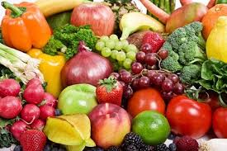
Food for Thought
It seems that there is never enough time in the day. But, since we all get the same 24 hours, why is it that some people achieve so much more with their time than others?

Slide 5
The answer lies in good time management.

Slide 6
What is Time?
Time is a resource allocated to all human beings equally but put to use differently and which can never be regained after use (Ruskin, 2017).

Slide 7
Time Management Defined
Time management is the process of organizing and planning how to divide your time between specific activities (Tracy, 2013).

Slide 8
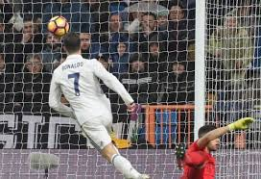
Reasons Why Students Ought to Internalize the Time Management Concept
Goal achievement
Effectiveness
Stress reduction

Slide 9
Perils Associated with Failure to imbibe Time Management
Success at endeavours is almost elusive
It will be herculean for such persons to live an organized life
Such persons are not usually painstaking in carrying out their duties but more often than not have to adopt a fire brigade approach
Poor time managers do not usually perform well as leaders

Slide 10
Learn to Set Goals
Students should understand the classes of goals namely:
i. short term goals
ii. Medium term goals
iii. Long term goals

Slide 11
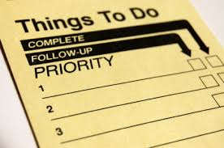
Prioritize Tasks to Achieve Set Goals
Scale of Preference Analogy from Economics

Slide 12
Nexus between Time Management and Prioritization of Tasks
Good Time Management will help you better achieve tasks in the order of priority you have chosen which will culminate in the achievement of set goals.

Slide 13
Avoid the Chief Time Waster
Procrastination

Slide 14
How to Avoid Procrastination
1. Break jobs into smaller tasks
2. Allocate enough time for complex work
3. If a task involves some form of creativity, do it when you are at your peak time of the day as regards to productivity
4. Always set deadlines for tasks

Slide 15
Nuggets on How to Improve Time management
Plan your time by making a “to do” list
Establish priorities for the various tasks and duties
Prepare a time budget & inventory
Keep a daily time log

Slide 16
CLOSING NOTE
“Ordinary people think merely of spending time, great people think of using it” - Arthur Schopenhauer

Slide 17
References
Ruskin, J (2017). Time Management. Retrieved January 2017, from: http://www.ohcs.gov.gh/sites/default/files/INDUCTION%202017%20-%20TIME%20MANAGEMENT_0.pdf
Tracy, B (2013). Time Management. Broadway, New York: American Management Association

